Slide 1
Operated by Los Alamos National Security, LLC,
for the U.S. Department of Energy
Staged Eigen-Emittance Reduction Techniques
Kip Bishofberger, Micha Ben-Naim, Bruce Carlsten,
Leanne Duffy, Rod McCrady, Nikolai Yampolsky
Los Alamos National Laboratory
Notes:
1
MaRIE = Matter Radiation Interactions and Extremes, a la Ms. Curie

Slide 2
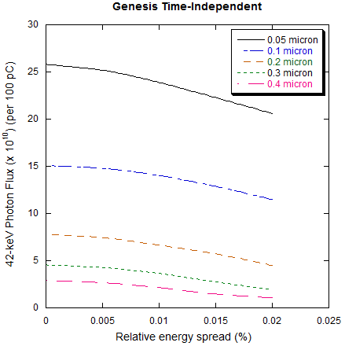
Eigen-emittances: Achieving 10e10 photons at 42 keV
 | UNIT | LCLS | MARIE 1.0 baseline
Wavelength | Å | 1.5 | 0.293
Beam energy | GeV | 14.35 | 12.0
Bunch charge | pC | 250* | 100 (250)
Pulse length (FWHM) | fs | 80* | 30 (75)
Peak current | kA | 3.0* | 3.4
Normalized rms emittance | mm-mrad | 0.3-0.4 | 0.2 (0.1)
Energy spread | % | 0.01 | 0.01
Undulator period | cm | 3 | 1.86
Peak magnetic field | T | 1.25 | 0.70
Undulator parameter, a_{w} |  | 2.48 | 0.86
Gain length, 1D (3D) | m | (3.3)* | (6.0)
Saturation length | m | 65 | 80
Peak power at fundamental | GW | 30* | 8 (17.6)
Pulse energy | mJ | 2.5* | 0.24 (2.4)
# of photons at fundamental |  | 2 x 10¹²* | 2x10¹⁰ (2x10¹¹)
*Y. Ding, HBEB, 11/09
PITZ photoinjector scaling:
Normalized emittance | PITZ photoinjector | REDUCTION TECHNIQUES
0.1 μm | 25 pC | 250 pC
0.2 μm | 100 pC | 1 nC
Notes:
2

Slide 3
Eigen-emittances: Two new concepts
  With the common discussion of highly-correlated beams, the term eigen-emittance has emerged to define the emittances of a particle distribution once all correlations are removed.
  It has been shown that the eigen-emittances are constants of linear, symplectic (Hamiltonian) transforms. The FBT is a perfect example of a beam with unique eigen-emittances, then removing correlations so the observed emittances equal the eigen-emittances.
  In addition, non-symplectic transforms are
  our method to change eigen-emittances.
conventional
beamline
elements
symplectic
non-symplectic
FBT (14x),
wedge foil,
ISR, etc?
Our motto: “Create a correlation non-symplecticly; then remove it symplecticly.”
Notes:
3

Slide 4
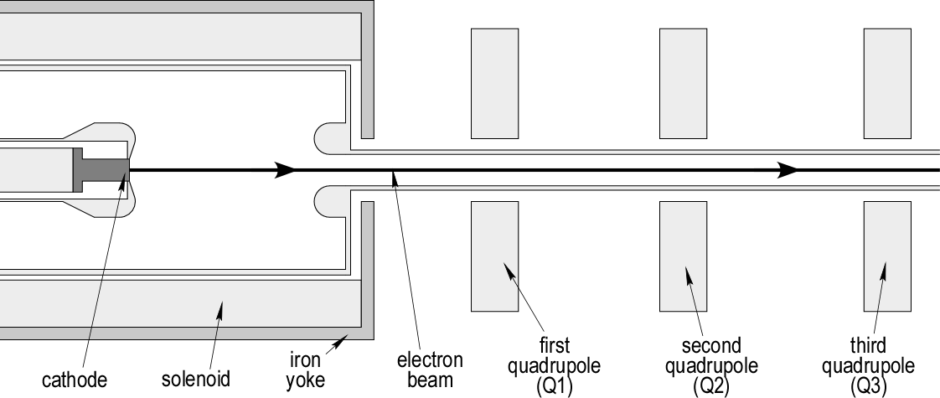
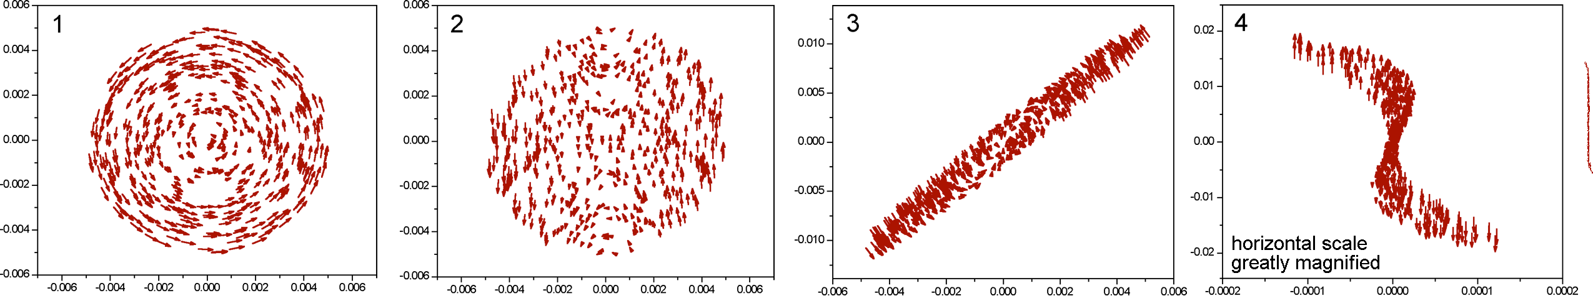
Initial Emittance Partitioning: Flat-Beam Transformer
Start with 250 pC round beam at cathode (0.35/0.35/4 μm)
FBT in the usual way gives 1.2, 0.1, 4 um emittances
Our motto: “Create a correlation non-symplecticly; then remove it symplecticly.”
Notes:
4

Slide 5
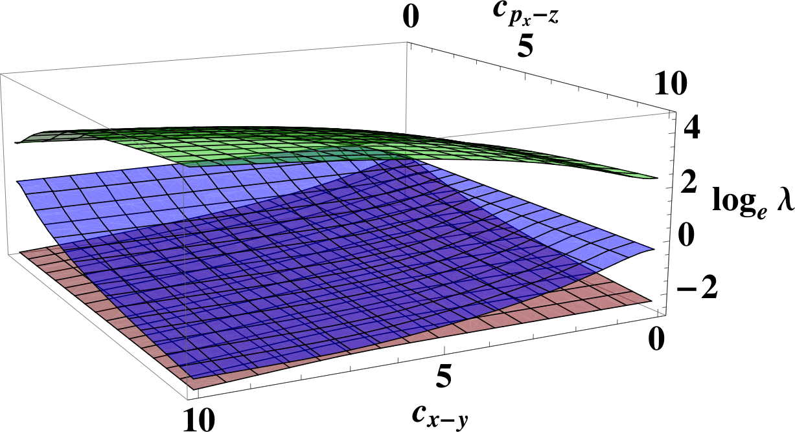
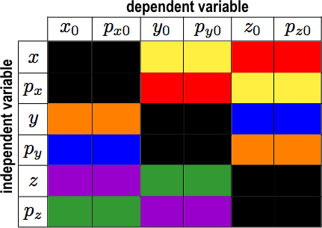
Initial Emittance partitioning: x-z, x-y Correlations
In order to reduce two eigen-emittances, two associated correlations must be generated non-symplecticly. Along with an FBT, hitting the cathode with the laser at an oblique angle generates a strong x-z correlation. Alternatively, a highly elliptical cathode (x-y correlation) with a tilted laser pulse is a possibility.
A major concern with all initial correlations is nonlinear forces before the beam is accelerated. Emittance dilution will impair the extreme emittance MaRIE requires.
Notes:
5

Slide 6
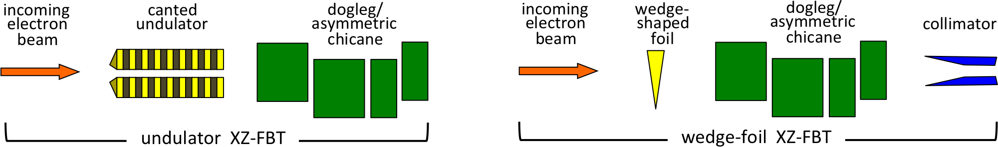
Second-stage XZ-FBT: Canted Wiggler
  Being a non-collective phenomenon, ISR acts as a non-symplectic transformation. By varying the magnetic field across the horizontal dimension of the the undulator, different electrons lose differing amounts of energy, generating the x-p_{z} correlation.
E in [GeV]
ΔE in [eV]
otherwise [mks]
  Our motto: “Create a correlation non-symplecticly; then remove it symplecticly.”
  We believe a canted-wiggler is the most promising approach to an XZ-FBT.
  With an intrinsic energy spread of a few keV, a 10-GeV beam only demands a 1E-4 energy slew. A 100-keV variation, using a 1-T undulator, requires 5 meters of length.
Notes:
6

Slide 7
Second-stage XZ-FBT: Wedge-shaped foil
  A second approach to generating a proper x-p_{z} correlation is a wedge-shaped foil that the beam passes through. One side of the beam loses more energy than the other side. However, the foil also scatters particles, creating an additional uncorrelated spread δ_{ind}.
E in [GeV]
ΔE in [eV]
otherwise [mks]
  Our motto: “Create a correlation non-symplecticly; then remove it symplecticly.”
  While not as ideal as a canted wiggler, this setup is easier for demonstration purposes. In addition, at lower energies, the canted wiggler’s length becomes extremely large.
Notes:
7

Slide 8
Second-stage XZ-FBT: Asymmetric chicane
  Both the canted-wiggler and wedge-foil techniques are non-symplectic methods to alter the beam’s eigen-emittances. In order to remove the correlations (symplectically), we can use a dogleg.
  An asymmetric chicane can also be used, and keeps the beam on the same trajectory (making it adjustable as well).
Notes:
8

Slide 9
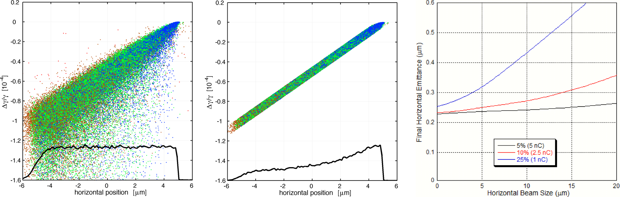
Simulation results: Wedge-shaped foil
  Using G4Beamline (Geant4), scattering and energy loss through the foil can be simulated. The following shows particle plots at 1 GeV:
  Due to the large energy distribution, it is necessary to collimate the remaining particles.
  The effectiveness of this technique increases with the severity of the collimation. Therefore starting with 1 nC to 5 nC, and collimating to 250 pC are considered for the wedge approach.
Notes:
9

Slide 10
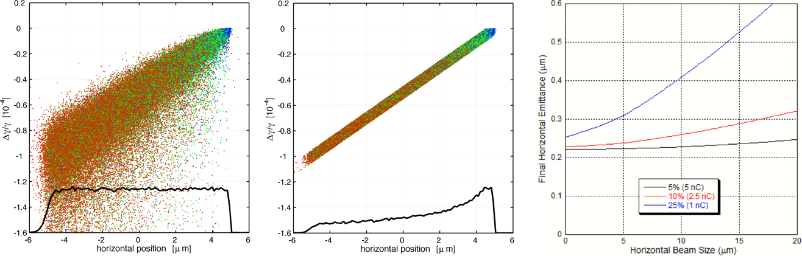
Simulation results: Wedge-shaped foil
  Similar results are shown for 100 MeV:
  At both energies, emittances of roughly 0.23 μm are achievable.
  Due to the simplicity of a wedge-shaped foil, we have proposed a number of demonstration options/collaborations: LANL NCRF injector, LANSCE, Fermilab, SLAC.
Notes:
10

Slide 11
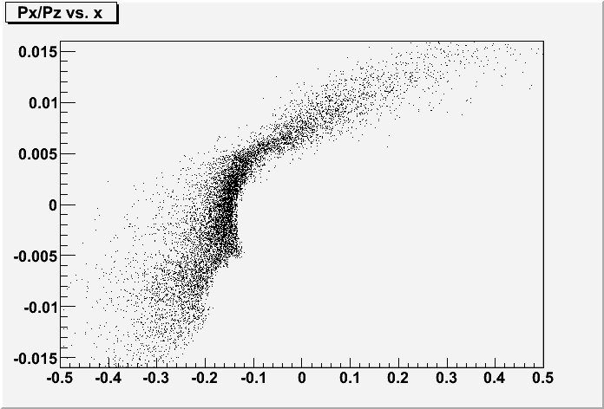

Demonstration option: Protons at LANSCE
  Simulation results for pushing 800-MeV protons through a foil are being performed (McCrady). With good emittance-reduction options being simulated, a possible demonstration is being considered in FY13.
  This would be the first demonstration of an XZ-FBT. Other experiments of a combined FBT/XZ-FBT beamline would be pursued elsewhere.
2e-3 energy slew (not enough)
no energy spread
1e-3 energy spread
Notes:
11

Slide 12
Summary
  Several options exist for production of a 0.1-µm-emittance beam at significant charge (250 pC) for future XFEL applications.
  It is possible that future photoinjectors possess this capability with built-in correlations.
  It is more attractive to have adjustable, staged FBT and XZ-FBT emittance reduction options. The XZ-FBT stage has yet to be demonstrated.
  Canted wigglers appear far superior to wedge-foil approaches. At high energies, the wiggler dimensions are not unrealistic.
  In the meantime, demonstrations of XZ-FBTs, using a foil at low energies, is an active pursuit of our group.
Notes:
12

Slide 13
Notes:
13

